Slide 1
Information in Electromagnetic Waves

Slide 2
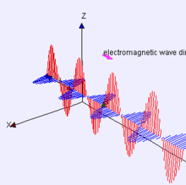
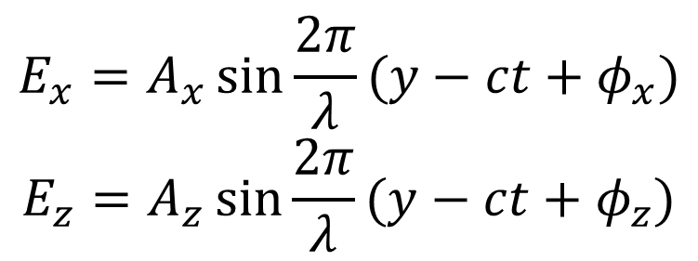
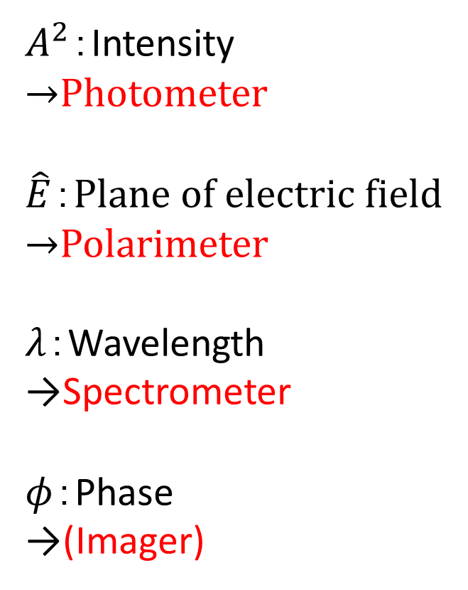
Electromagnetic Waves
$A^{2}$：Intensity
→Photometer
$\hat{E}$：Plane of electric field
→Polarimeter
$λ$：Wavelength
→Spectrometer
$φ$：Phase
→(Imager)
$$E_{x}=A_{x}\sin{\frac{2π}{λ}(y−ct+φ_{x})}$$
$$E_{z}=A_{z}\sin{\frac{2π}{λ}(y−ct+φ_{z})}$$

Slide 3
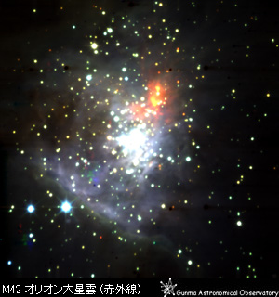
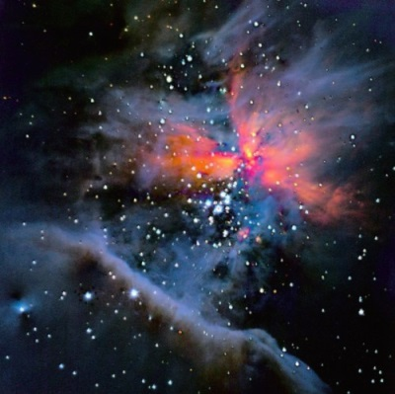
Information in E-M Waves
Method | Available physical parameters
Imaging | Size, Morphology
Photometry | Flux Intensity
Spectroscopy | Radial Velocity, Dynamics, Temperature, Radiation Process, Component (atoms, molecules)
Polarimetry | Radiation Process, Asymmetry of Radiation process
Astrometry | Distance and Velocity on the sky
Time-series | Transient objects (Super novae, Exoplanet, etc)

Slide 4
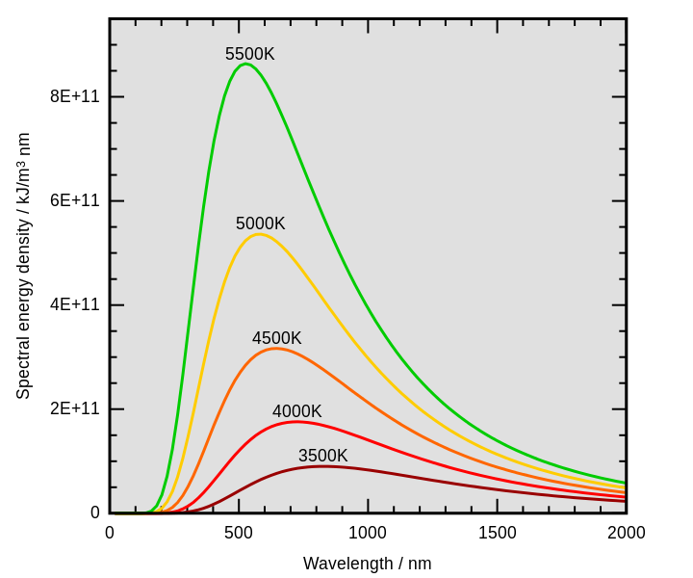
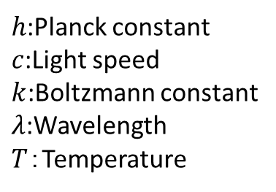
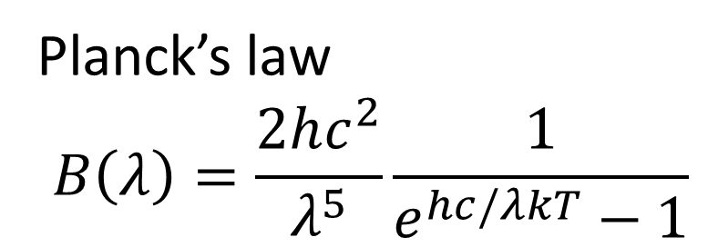
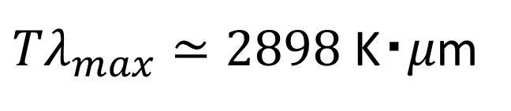
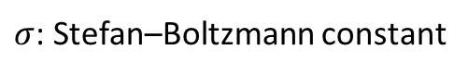
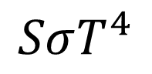
Black-Body (Thermal Radiation)
Most of the objects shine with black body or quasi black body radiation.
$h$:Planck constant
$c$:Light speed
$k$:Boltzmann constant
$λ$:Wavelength
$T$：Temperature
Planck’s law
$$B\left(λ\right)=\frac{2hc^{2}}{λ^{5}}\frac{1}{e^{hc/λkT}−1}$$
The peak wavelengths that characterize the spectrum of blackbody radiation follow the Wien's displacement law
${Tλ}_{max}≃2898 \text{K}・μ$m
The total radiant energy from the area 𝑆 temperature 𝑇 blackbody is
$$SσT^{4}$$
$σ$: Stefan–Boltzmann constant

Slide 5
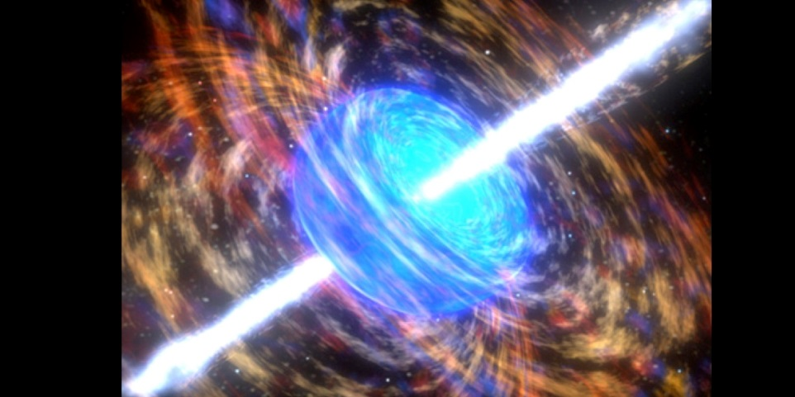
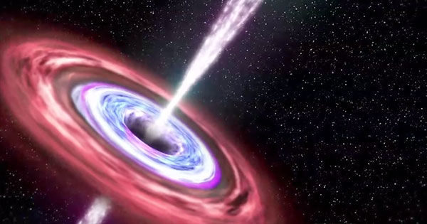
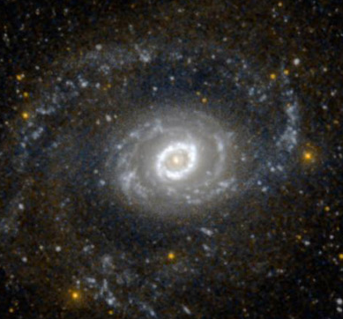
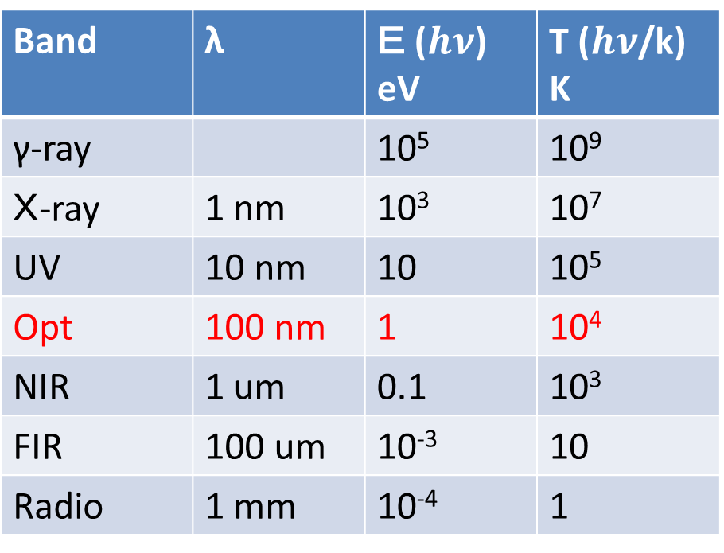
Energy of E-M waves
γ-ray: ex. Supernova
X-ray: ex. Blackhall
Band | λ | Ｅ ($hν$) eV | T ($hν$/k) K
γ-ray |  | 10⁵ | 10⁹
Ｘ-ray | 1 nm | 10³ | 10⁷
UV | 10 nm | 10 | 10⁵
Opt | 100 nm | 1 | 10⁴
NIR | 1 um | 0.1 | 10³
FIR | 100 um | 10⁻³ | 10
Radio | 1 mm | 10⁻⁴ | 1
UV: ex. Massive star

Slide 6
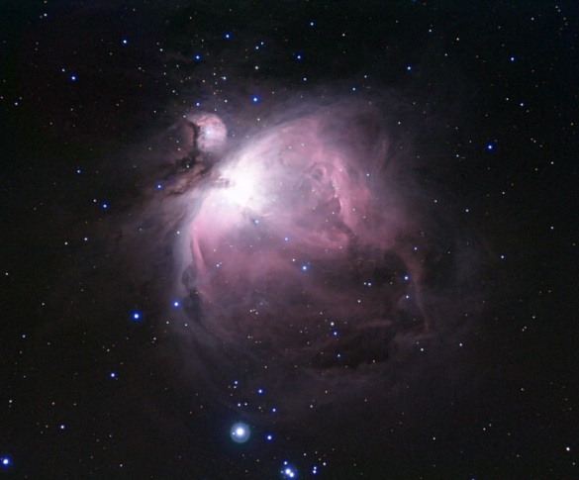
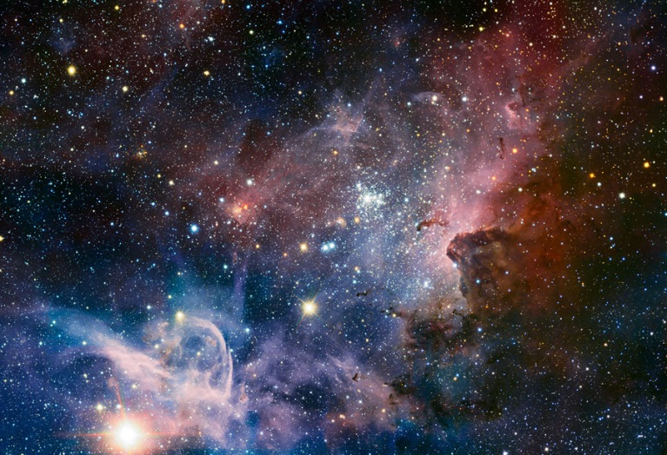
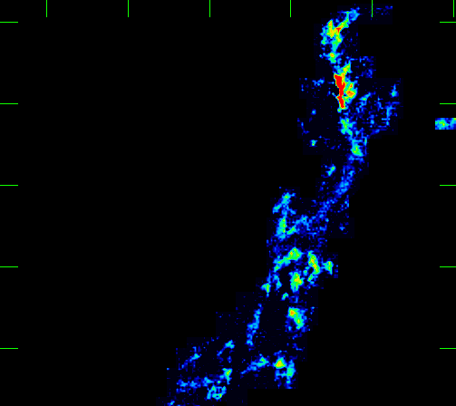
Energy of E-M waves
Opt: ex. Star
IR： ex. Low-mass star,
Interstellar matter and dust
Band | λ | Ｅ ($hν$) eV | T ($hν$/k) K
γ-ray |  | 10⁵ | 10⁹
Ｘ-ray | 1 nm | 10³ | 10⁷
UV | 10 nm | 10 | 10⁵
Opt | 100 nm | 1 | 10⁴
NIR | 1 um | 0.1 | 10³
FIR | 100 um | 10⁻³ | 10
Radio | 1 mm | 10⁻⁴ | 1
Radio: ex. Low temperature gas
and molecular cloud

Slide 7
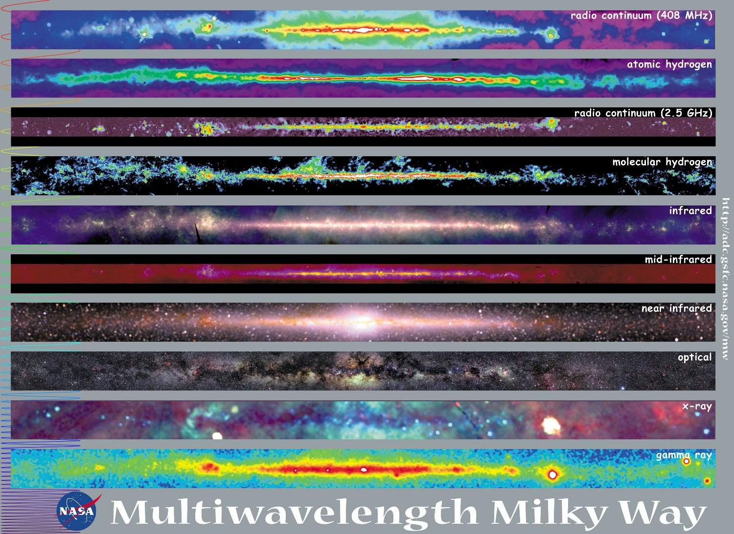

Slide 8
Imager
A device for acquiring a two-dimensional image. The simplest imaging device, shown at left, places the detector directly at the focal plane of the telescope. Usually, a filter is inserted to observe at a specific wavelength.
Advantages：
You can make it without additional optics with low cost
Disadvantages：
It is not applicable to large telescopes which have long focal lengths and large magnifications that make the image too large for the pixel size of the detector, and the field of view is strictly limited.
A filter wheel is required to observe multiple bands. It is necessary to take into account that the focal length does not change with the filter when the filter is replaced. Employing a filter wheel, the filter cannot be placed immediately in front of the detector. This makes the filter larger.
At bright f-numbers, the range of angles of light rays incident on the filter increases, resulting in non-uniform transmission characteristics of the filter.
Ray from a telescope
Filter
Detector
Imager
(Simplest case)

Slide 9
Multi-band Imager with a Dichroic Mirror
By inserting a dichroic mirror in the optical path that transmits the longer wavelength and reflects the shorter wavelength, wavelengths can be observed simultaneously at multiple wavelengths.
Advantages:
Simultaneously multi-band observation is available without filter wheel and loss time.
the filter can be placed immediately in front of the detector and they get smaller.
Stable instrument without movable components.
Disadvantages:
Multiple detectors are required, and it leads cost increasing.
Dichroic mirror
Detector
Filter
Flter
Detector
Multi-band Imager

Slide 10
Imager with a Collimator and F-conversion
Telescope focal plane
Collimator: After telescope focal plane, the collimator optics collimates the ray.
Advantages:
All rays of light enter the filter almost vertically, and the filter can work uniformly.
The telescope f-number can be converted by imaging lens to fit the image size to the detector's pixel size.
The aperture stop can be placed to block light coming from outside the telescope (preventing stray light). In case of IR instrument, cooling the aperture can dramatically reduce background radiation in the infrared region above 2um, where background radiation is large.
Collimator
Aperture stop
Filter
Imaging lens/
F-conversion
Detector

Slide 11
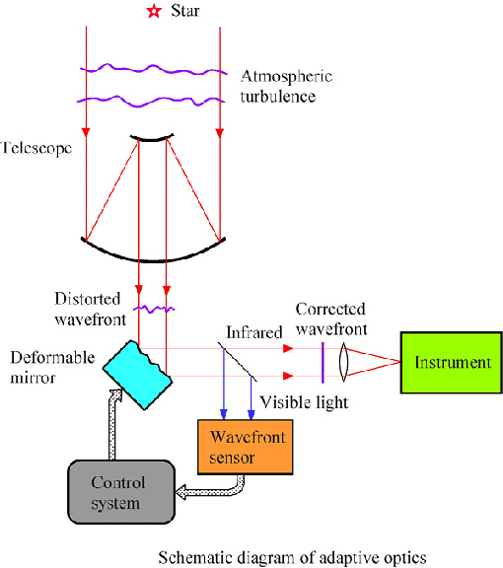
Adaptive Optics
Light from stars (wavefront) is distorted by the atmosphere
↓
The Sensor detects wavefront distortion with infrared band
↓
The control system calculates the amount by which the deformable mirror should deform.
↓
The Deformable mirror instantly deforms to correct the distortion of the wavefront
↓
The Deformable mirror instantly deforms to correct the distortion of the wavefront
↓
The corrected wavefront of visible band is focused on the detector.
Wavefront distortion depends on the nature of the atmosphere and wind speed at the observation site. The better the observation site, the smaller the distortion.

Slide 12
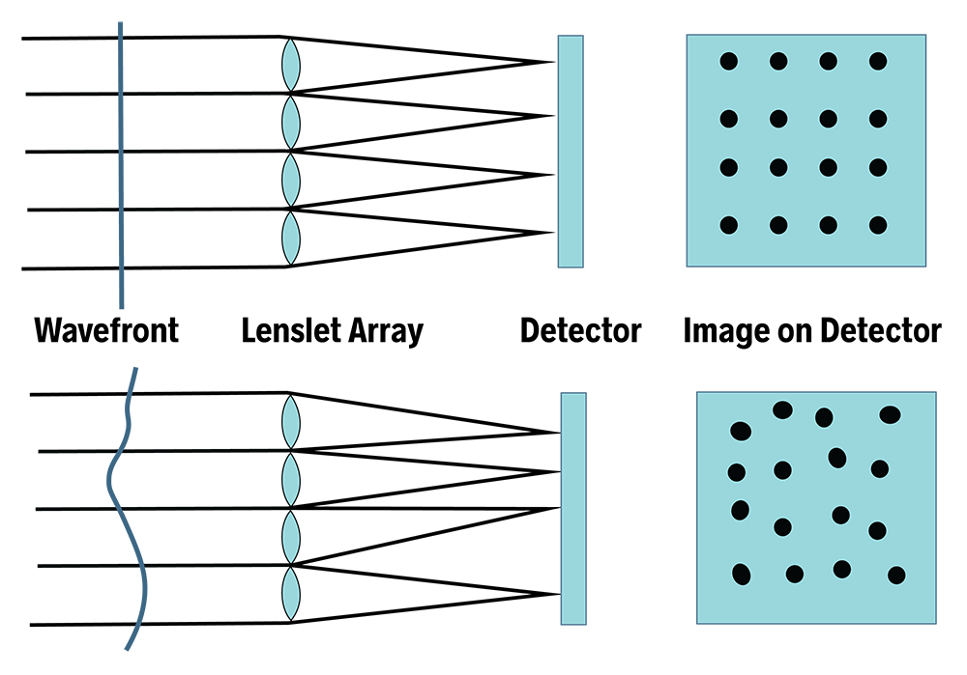
Shack Hartmann Wavefront Sensor
When the incoming wavefront is planar (ideal), the spots on the detector will appear in a regularly spaced array.
By analyzing how much each spot has displaced you can determine the error in the incoming wavefront.

Slide 13
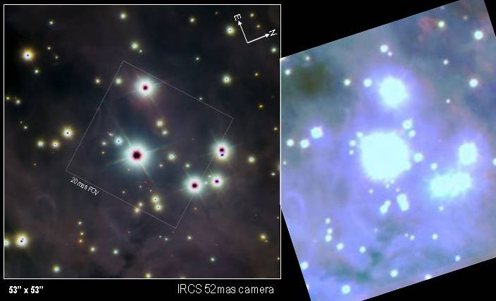
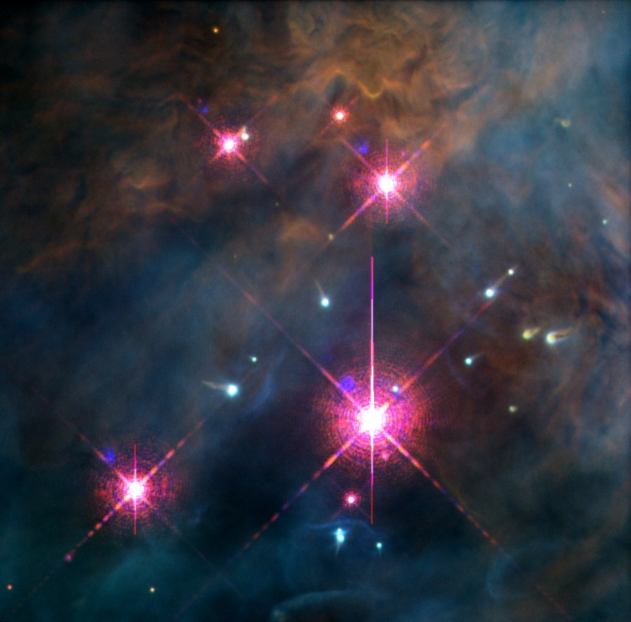
Subaru 8m Telescope（Without AO）
Point sources were blurred
HST 2.4m
HST does not suffer the air turbulence
Subaru with AO

Slide 14
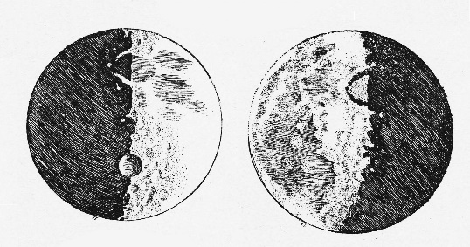
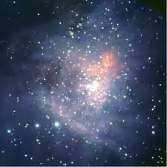
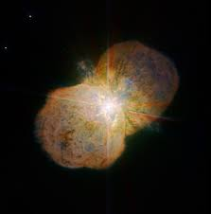
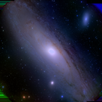
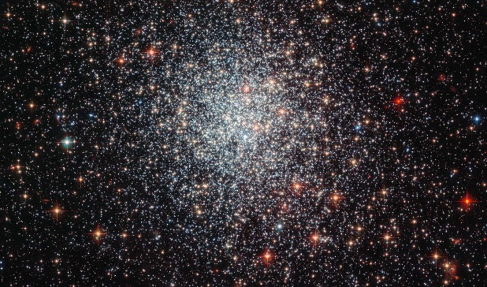
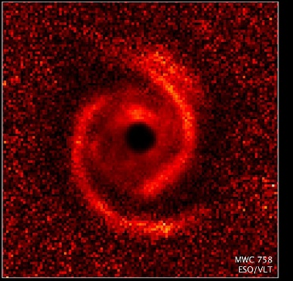
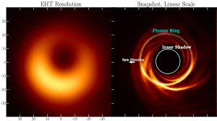
Ex. Imaging Observation
Galilean moons around Jupiter, Crater of the Moon, Stars in the Milky way
Star forming region
Protoplanetary Disk
Mass loss from massive star
Black hall shadow
Cosmic microwave background
M42
IRSF/Nagoya Univ.
Eta Carinae
VLT/ESO
NGC1783
HST/NASA
MWC 758
VLT/ESO
Blackhall Shadow
EHT
Subaru/NAOJ

Slide 15
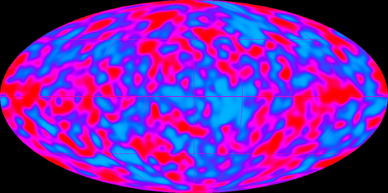

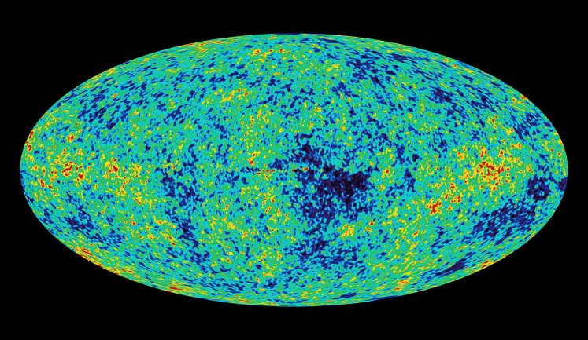
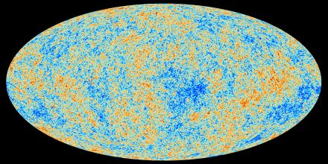
Ex. Imaging Observation
COBE
1989
WMAP
2001
Galilean moons (Sidereal Messenger)
Plank
2009
Microwave back ground

Slide 16
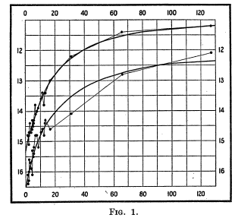
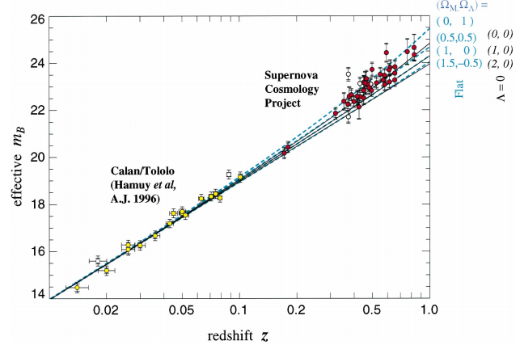
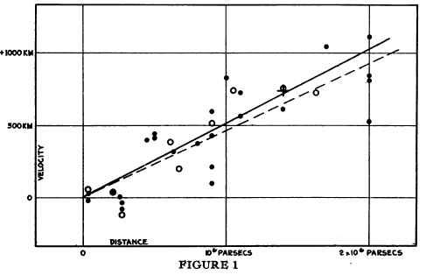
Ex. Photometric Observation
Thanks to CCD and CMOS detectors, recent Imaging cameras work well as photometers.
1912 Leavitt discovered period-luminosity relationship for Cepheid variables, which extended the distance ladder to the near galaxies at once.
1929 Hubble discovered expansion of the universe with photometric and spectroscopic observation on nearby galaxies
1999 Perlmutter+ discovered Accelerating expansion of the universe with photometric and spectroscopic observation on Type Ia super novae.
Leavitt（1912）
Period-luminosity relationship
Hubble （1929）
Redshift of galaxies
Perlmutter（1999）
Accelerating expansion of the universe

